Slide 1

Analysis of Rocket League Replay Metrics: Machine Learning Classification and “Game Performance”
Andrew J. Otis

Slide 2
Purpose of Project
Sports analytics is nothing new, but what is relatively new in the industry of Professional Athletics would be E-sports, bringing a wide variety of data. Every video game will have data in common, but there’s also a lot of data unique to each individual game (e.g. baseball vs basketball).
I will be comparing various classification algorithms to see which one is most appropriate to the data.

Slide 3
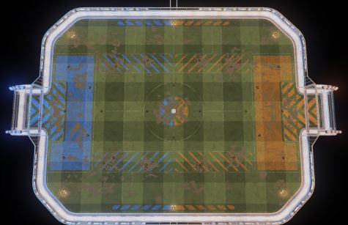
Significance of Project
As seen on T.V. sports analytics are a big part of what makes up the “experience”. Insights from game data can be advantageous to all those involved, from players to officials, and even game developers.

Slide 4
Research Questions
1. What Machine Learning models would be appropriate for predicting whether a player is mvp or not?
2. Can an equation be derived to calculate what will be called “game performance” to predict whether a player is mvp or not?

Slide 5
Description of dataset
The dataset consists of multiple web scrapes from the site https://ballchasing.com.
Any player with an online account from a supported platform can post metrics of their game, this includes professional and casual games. The features of the data set include almost every data type, including location data and columns that have multiple categories for a single response.
In essence the main dataset has the dimensions (201 rows x 136 columns).

Slide 6
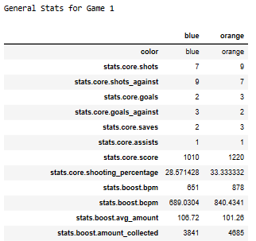
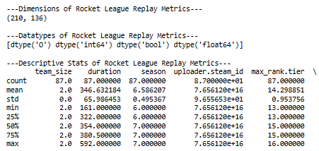
Exploratory Data Analysis
First, descriptive statistics of all the data’s numeric columns were collected, then general team statistics for each game were isolated and then explored via an indexable list of tables.

Slide 7
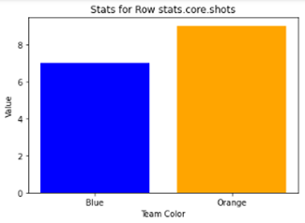
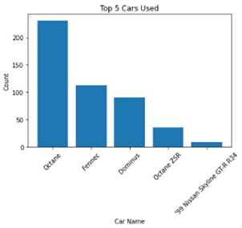
Visualization
A bar plot is constructed from the general team stats for a non-table visual as well as the player stats to create another bar plot to determine which care was utilized the most

Slide 8
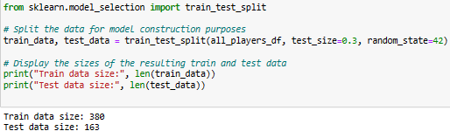
Data Splitting
A train and test set were created from the main dataset using a 70-30% split ratio.

Slide 9
Model Building
Data assumptions for a logistic classification model were checked. The assumption for a binary output variable has already been met so first, a scatterplot of all possible input variables against the output variable to visualize if any features had a linear relationship with the output variable.
Then a check for independence of observation with a correlation matrix was done. Which is then followed by a check of Multicollinearity using a statsmodels package.
Finally, the models are trained with the training data and then used to make predictions on test sets.

Slide 10
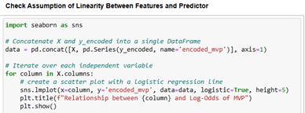
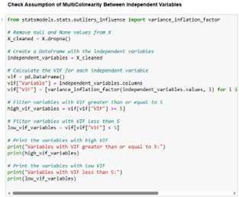
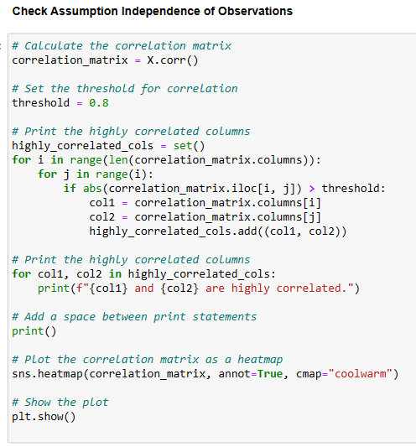
Model Building

Slide 11
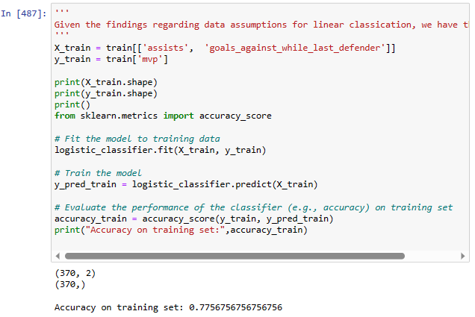
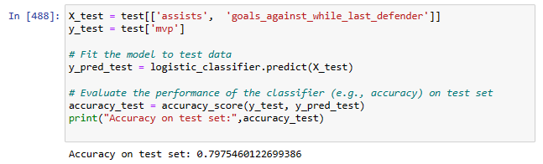
Model Building
Code for building the logistic classifier model

Slide 12
Feature Selection
Based on the nature of the report and exploratory analysis the following features and output variable were selected
X_train = train[['assists', 'goals_against_while_last_defender’]]
y_train = train['mvp']

Slide 13
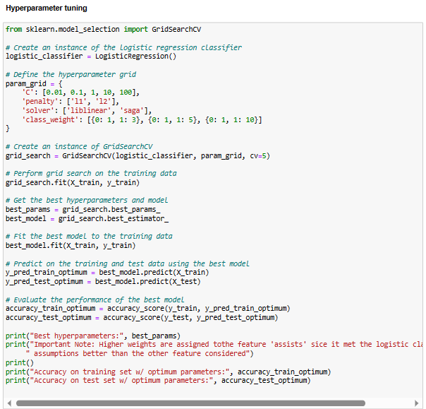
Model Selection and Optimization
Hyperparameters for each model are adjusted to see if the classification model would perform better than default parameters. In one case, tuning resulted in a model performing worse.
Provided, is a snapshot of the code when
optimizing the parameters of the logistic
classification model.

Slide 14
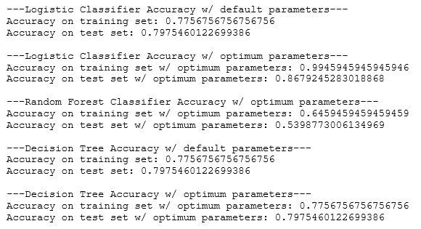
Model Comparison

Slide 15

Conclusion
The equation for game performance was determined as follows, resulting in an accuracy score of about 54%.
$$game performance =0.9∗assists+0.1∗goals_against_while_last_defender$$
In conclusion, it was determined that the decision tree model was best suited for working with the data set and goals of the analysis. This is due to the decision tree being the only model that did not overfit the data
The random forest and logistic models did not perform well, indicated by overfitting the data, but the decision tree model had a decent performance on new data and the model did not overfit the data.

Slide 16
Lessons Learned
The process of model building allowed me to identify features that affected the prediction the most so the efforts were not fruitless.
. When collecting data from a source that updates frequently, it is important to consider how that might affect one’s analysis because new data that was not originally considered could be introduced in place of data scraped the day before

Slide 17
Recommendations
It is recommended that the data be saved at various stages of the program so that an individual would not have to re-scrape the data in order to run the analysis. This not only saves time but maintains consistency in findings as the model is built and tested due to the source site updating whenever someone decides to post their replay metrics.

Slide 18
References
Image
Nickolas Carroll, (2021, March 17), How to Watch Rocket League, esports.missouri.edu. https://esports.missouri.edu/how-to-watch-rocket-league/
lethamyr.com, (n.d.) Top Down Rocket League, lethamyr.com. https://lethamyr.com/mymaps/top-down-rocket-league
Online
Ballchasing.(n.d.). Ballchasing.com. Retrieved May 20, 2023, from https://ballchasing.com
Ballchasing.(n.d.). API Documentation. Ballchasing.com. Retrieved May 20, 2023, from https://ballchasing.com/doc/api
Ballchasing.(n.d.). Frequently Asked Questions (FAQ). Ballchasing.com. Retrieved May 20, 2023, from https://ballchasing.com/doc/faq
Hockey-Graphs. (2016, July 13). Measuring Single-Game Productivity: An introduction to Game Score. Hockey-Graphs. Retrieved May 20, 2023, from https://hockey-graphs.com/2016/07/13/measuring-single-game-productivity-an-introduction-to-game-score/
Course
Dalton. (2023). Data Science Tools II [COMP4448]. University of Denver.

